Slide 1
Movie Recommender System

Slide 2
01
02
TABLE OF CONTENTS
INTRODUCTION
EXPLORATORY DATA ANALYSIS
03
04
USER-USER COLLABORATIVE FILTERING
ITEM – ITEM COLLABORATIVE FILTERING

Slide 3
01
INTRODUCTION
Problem Overview
Context and Objective

Slide 4
In the age of digital media, personalized content delivery is paramount to the user experience. Movie recommendation systems are at the heart of this personalization, guiding audiences through an overwhelming sea of choices to discover content that resonates with their tastes and preferences. As streaming services and online platforms become the primary means of movie consumption, the role of data-driven recommendation algorithms has become increasingly critical.
Problem Overview
Youtube
Watchtime
Movies Watched
Netflix
McKinsey Survey
Google Play
Installs
Amazon
Purchases

Slide 5
Context and Objective
The focus of this analysis is two-fold:
Synergy of Python and MongoDB: This part emphasizes the powerful combination of Python's data processing prowess with MongoDB's flexible data structures. The goal is to showcase the efficiency in handling complex, multi-field queries, especially in the context of in-depth exploratory data analysis (EDA).
Collaborative Filtering for Personalized Recommendations: Here, the discussion revolves around the concepts of User-User and Item-Item Collaborative Filtering. The aim is to illustrate how these techniques are applied in practice, particularly for personalizing movie recommendations. This section will highlight the effectiveness of collaborative filtering in enhancing user experience and boosting engagement.
The ultimate objective is to demonstrate a seamless integration of Python and MongoDB for conducting comprehensive exploratory data analysis and collaborative filtering, specifically in the context of movie rating data.

Slide 6
02
Exploratory Data Analysis

Slide 7
DATA
This project utilizes a condensed version of the MovieLens dataset, available on Kaggle. This smaller dataset still offers a comprehensive view of movie ratings, tags, and metadata, making it suitable for a variety of analyses.
Links
Movies
Tags
Ratings
Connects movies to IMDb and TMDb IDs for external reference
Basic movie information including title and genres
User-generated tags providing insights into viewer opinions
Viewer ratings for movies, indicating popularity and preference

Slide 8
Strategic Integration of MongoDB and Python
Synergistic Approach
Data Indexing for Performance Optimization
MongoDB Aggregation for Insights
Utilized Python's robust data handling capabilities alongside MongoDB’s flexible data modeling
Enhanced data processing and analysis efficiency through Python-MongoDB integration
Implemented indexing on key fields like movieId and userId to expedite query responses
Enhanced data retrieval efficiency, especially for large-scale queries
Used single field indexes for straightforward queries and compound indexes for complex, multi-field queries
Utilized MongoDB's aggregation pipeline for multifaceted data analysis
Example: Genre popularity analysis via splitting, grouping, and sorting operations
Python scripts to initiate and handle complex aggregation queries
Transformed aggregation results into Pandas DataFrames for further analysis.

Slide 9
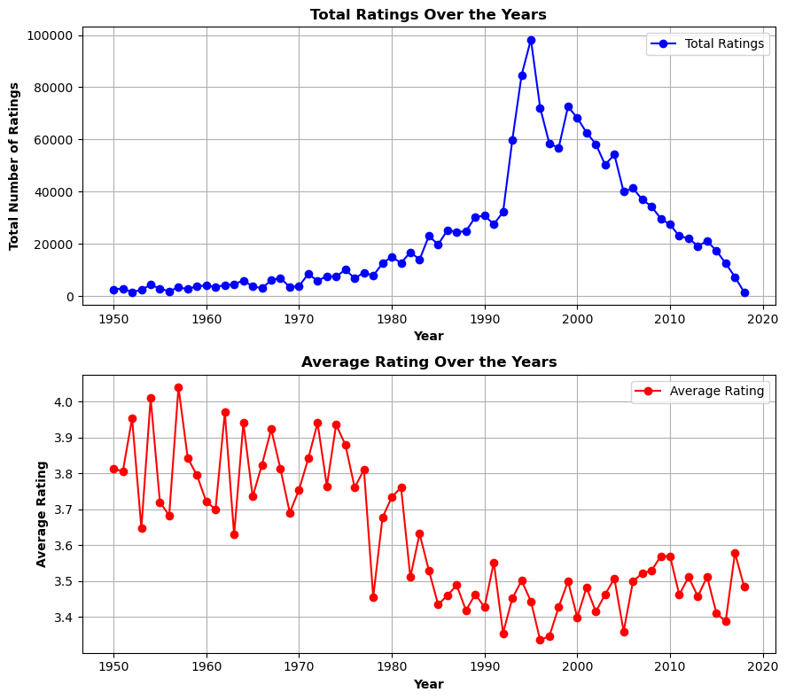
Trends in Ratings
Total Ratings Trend Analysis
Significant increase in the total number of ratings from the late 1980s, peaking around the early 2000s
Noticeable decline post-peak, possibly due to shifts in preferences
Average Rating Fluctuations
Average ratings fluctuated between 3.6 and 4.0, with a period of higher averages during the 1950s to 1960s
A gradual decline in average ratings from the 1960s to the 1980s, followed by stabilization around 3.6 to 3.8 since the 1990s
Decade-Specific Insights
1950s-1960s: A golden era with consistently higher average ratings, indicating a trend of critically acclaimed movies
1970s-1980s: Transition period with more variability in average ratings
1990s-2000s: Surge in movie production and ratings given, with a broader distribution of quality

Slide 10
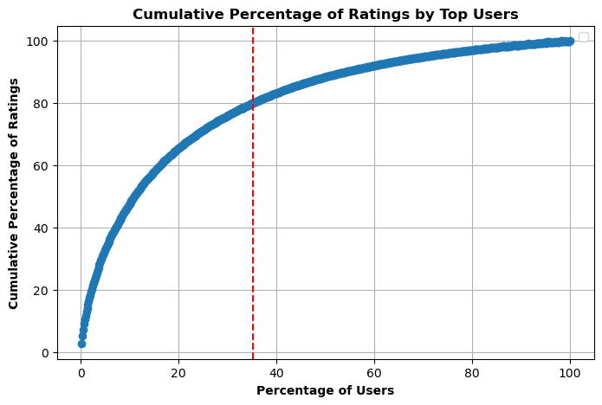
Pareto Analysis of User Ratings
The Pareto Principle, also known as the 80/20 rule, is a principle that suggests that roughly 80% of effects come from 20% of causes
In our dataset, 35% of users are responsible for 80% of the ratings
This means that a small subset of users, likely the most active and engaged, are disproportionately responsible for the bulk of the ratings
This heavy skew towards 'power users' is a common online engagement pattern and aligns with the 80/20 rule observed in various domains
It may signal the need for diversifying the user base to avoid bias in recommendations and market analysis

Slide 11
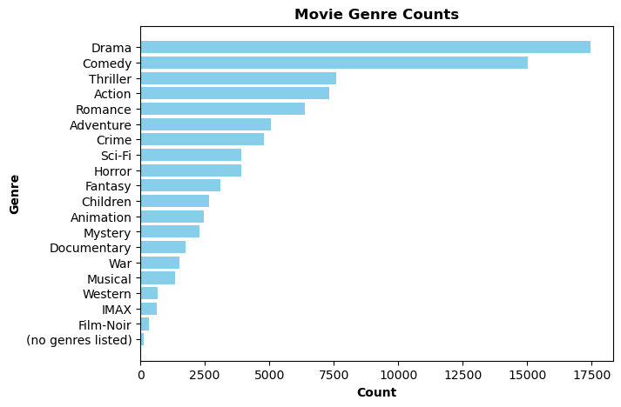

Trends in Ratings
Genre Popularity Distribution:
Drama and Comedy are the most prolific genres, far exceeding others in movie counts
The presence of Thriller and Action genres also indicates a strong audience interest in high-stakes, adrenaline-driven content.
Word Cloud Interpretation:
The prominence of words like 'Drama', 'Comedy', 'Action', and 'Romance' in the word cloud visually reinforces their status as the most common genres
The size disparity in the word cloud suggests a significant drop-off in frequency from these top genres to more niche ones like 'Film-Noir' and 'IMAX'

Slide 12
03
User-User Collaborative Filtering

Slide 13
User-User Collaborative Filtering
Collaborative filtering is a popular technique in recommendation systems that leverages user behavior and preferences to make personalized recommendations.
Step 1: User-Rating Interaction Matrix
We start by creating a user-rating interaction matrix from the data
The interactions could represent various aspects of user behavior, such as the number of times a movie was watched, whether a movie was ever watched or not, etc.
For our analysis. we have chosen to focus on "ratings" as our metric
Each row represents a user, each column represents a movie, and the cells contain the user ratings
Sample User-Product Interaction Matrix
User|Rating | Movie 1 | Movie 2 | Movie 3 | Movie 4
User 1 | a | b | c | d
User 2 | e | f | g | h
User 3 | i | j | k | l
User 4 | m | n | o | p
For instance, User 1 has given Movie 1 a rating of ‘a’ and so on
This matrix is used to compute the similarities between users and to make recommendations based on those similarities.

Slide 14
User-User Collaborative Filtering
Step 3: Recommend Movies
Inputs the user ID of the user for whom we want to generate movie recommendations
Identifies users with the highest similarity scores to the target user from the user-user similarity matrix, computed using cosine similarity
Computes movie scores by aggregating ratings from similar users, weighted by their similarity to the target user
Omits movies the target user has already rated
Ranks movies by their aggregated scores and selects the top N for recommendation.
The Recommender System:
Recommendations for a Sample User:
Input User ID
User ID 186444
User Interaction Matrix
Cosine Similarity
Top 5 Recommended Movies:
Braveheart (1995)
Shawshank Redemption (1994) Terminator 2: Judgment Day(1991) The Godfather(1972)
Lord of the Rings: The Fellowship of the Ring (2001)
Identify Similar Users
Compute Movie Scores
Recommend top N Movies

Slide 15
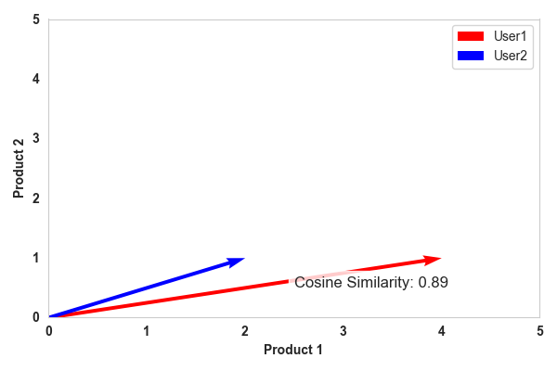
User-User Collaborative Filtering
Sample Cosine Similarity chart
Step 2: Cosine Similarity
With the interaction matrix in place, we calculate the cosine similarity between users
We treat each row (user) in the matrix as a vector in an N-dimensional space (with N being the number of Movies)
We compute the cosine of the angle between every pair of user vectors to determine their similarity
The resulting similarity scores form a new matrix (the similarity matrix) where each entry represents the similarity score between two users
Note that a cosine similarity score of 1 would mean the vectors are identical in orientation, indicating very similar preferences, while a score of 0 would mean the vectors are orthogonal, indicating completely dissimilar preferences.

Slide 16
04
Item-Item
Collaborative Filtering

Slide 17
Item-Item Collaborative Filtering
In Item-Item collaborative filtering, the interaction matrix structure is similar, but the focus shifts:
Rows represent Items (Movies), columns represent Users, and cells still hold the Ratings given by a user to a particular item.
This shift in focus allows the system to compute similarities between Movies based on their ratings, rather than between Users as in User-User collaborative filtering
Similar to User-User CF, employs Cosine Similarity to compute Item-Item similarity based on training data
This results in a similarity matrix representing the likeness between movies
In item-item collaborative filtering, the input is a movie, not a user, to generate top N recommendations
The Recommender System:
Recommendations for a Sample Movie:
Input Movie ID or Name
Jurassic Park (1993)
Item Interaction Matrix
Cosine Similarity
Top 5 Recommended Movies:
Shrek (2001)
Dark Knight, The (2008)
Good Will Hunting (1997)
Inception (2010)
sKill Bill: Vol. 1 (2003)
Identify Similar Movies
Compute Movie Scores
Recommend top N Movies

Slide 18
Evaluation of Collaborative Filtering Analysis
Evaluation Metric: RMSE
User-User
Item-Item
The User-User Collaborative Filtering model demonstrated a superior performance with a Test RMSE of 0.3042
This indicates a high level of precision in predicting user preferences by analyzing and learning from the behavior of similar users
The Item-Item Collaborative Filtering model exhibited a Test RMSE of 0.3544, which is higher compared to the User-User model
However, this model is particularly valuable in situations where we need to recommend new items but user data is sparse

Slide 19
Wrapping Up
The following table summarizes our key findings with regards to Collaborative Filtering:
Aspect | User-User | Item-Item
Approach Focus | Focuses on finding users similar to the target user and recommending items based on what similar users have liked | Focuses on finding items similar to those the user has already rated or interacted with and recommends similar items
Personalization vs. Scalability | Offers a high level of personalization as it tailors recommendations to individual user preferences | More efficient and scalable, making it a better choice for handling large datasets, and it can be robust in dealing with the "cold start" problem for new users or items
Level of Personalization | Provides a higher level of personalization, capturing nuances in individual user preferences more effectively | While efficient, may not offer the same level of personalization as it focuses on item similarities and may overlook user-specific preferences

Slide 20
Recommendations and Enhancements
1. User Segmentation: Enhance the analysis by segmenting users based on demographics or viewing habits, which can lead to more nuanced recommendations.
2. Cross-Platform Data Integration: If possible, integrate data from multiple platforms (e.g., Netflix, Amazon Prime) for a more comprehensive recommendation engine.
3. Balance User Influence: Develop methods to ensure recommendations reflect diverse user interests, not just 'power users'.
4. Real-Time Recommendations: Aim for real-time recommendation capabilities to reflect the most current user preferences and trends.

Slide 21
Keep Enjoying Amazing Movies

